Slide 2
Përmbajtja
Hyrje ne Sistemet Operative
Struktura e Sistemeve Operative
Menaxhimi i Proceseve
Threads & Concurrency
Skedulimi i CPU, Sinkronizimi, Deadlocks
Menaxhimi i Memories, Memoria Kryesore dhe Virtuale
Struktura e Sistemeve për Ruajtjen e Shënimeve
I/O Sistemet, dhe Konfigurimi i Pajisjeve
Ndërfaqja dhe Implementimi i File Sistemeve
Mbrojtja dhe Siguria
Virtualizimi, Cloud Computing
Rrjetet dhe Sistemet e Shpërndara

Slide 3
Topic 3 - Recap
Process Concept
Process Scheduling
Operations on Processes
Interprocess Communication
IPC in Shared-Memory Systems
IPC in Message-Passing Systems
Examples of IPC Systems
Communication in Client-Server Systems

Slide 4
Outline
Overview
Multicore Programming
Multithreading Models
Thread Libraries
Implicit Threading
Threading Issues
Operating System Examples

Slide 5
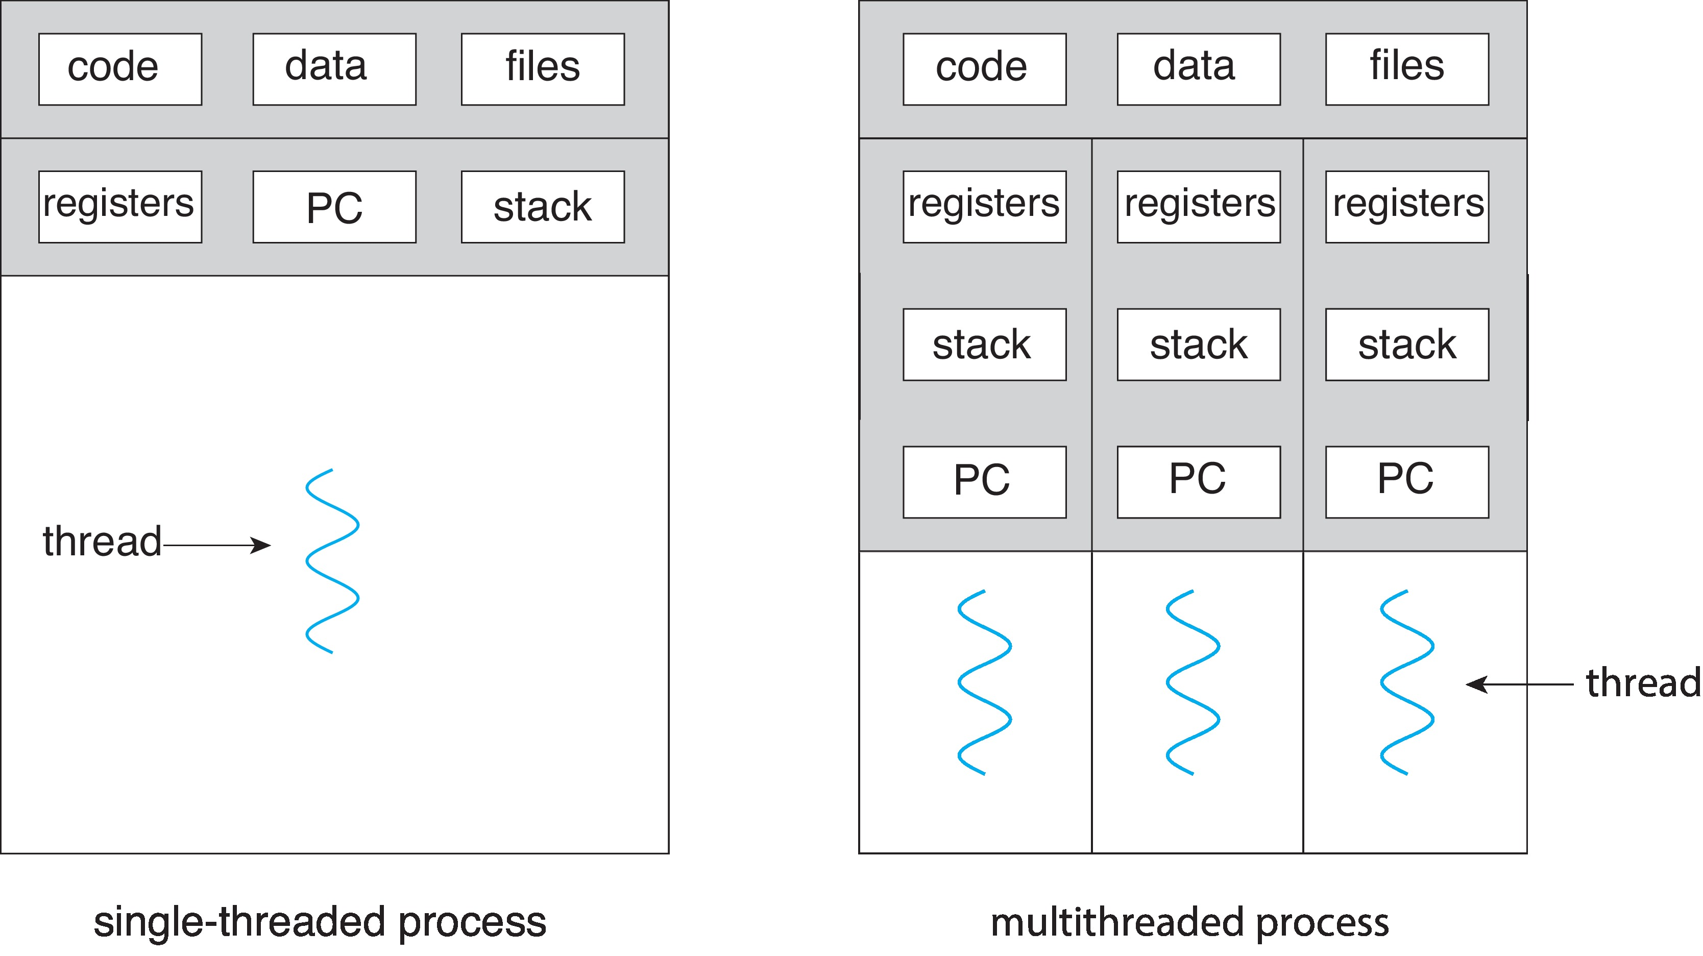
Single and Multithreaded Processes

Slide 6
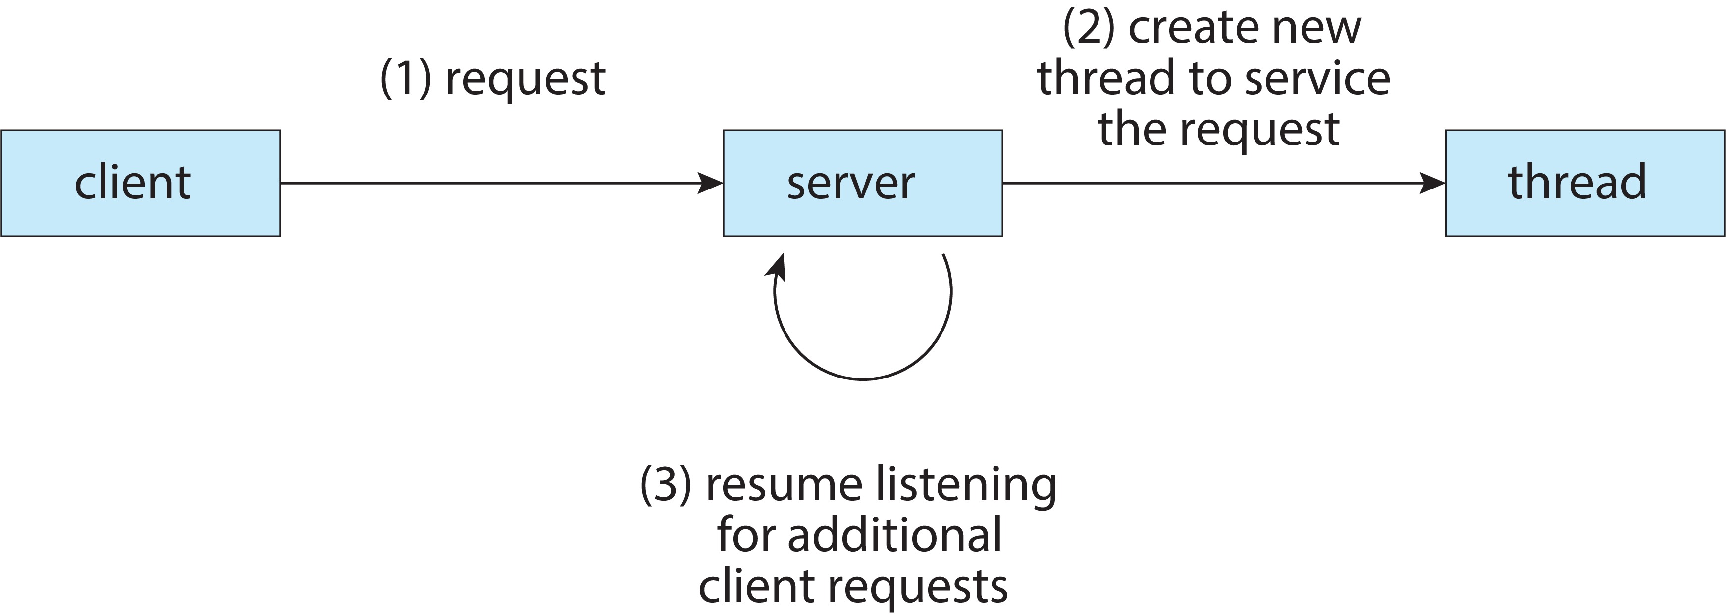
Multithreaded Server Architecture

Slide 7
Benefits
Responsiveness – may allow continued execution if part of process is blocked, especially important for user interfaces
Resource Sharing – threads share resources of process, easier than shared memory or message passing
Economy – cheaper than process creation, thread switching lower overhead than context switching
Scalability – process can take advantage of multicore architectures

Slide 8
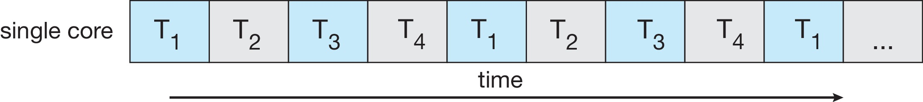
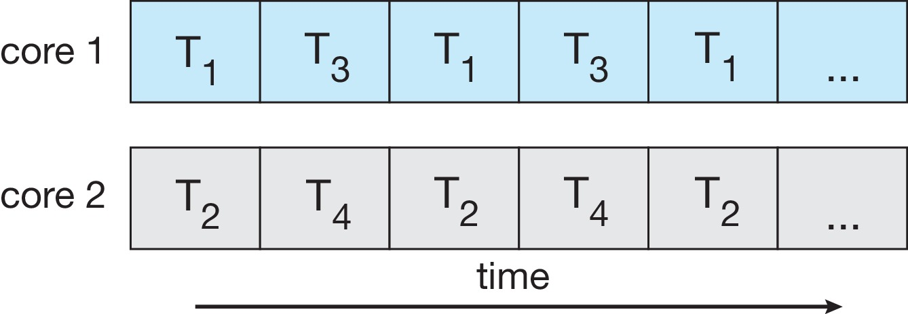
Concurrency vs. Parallelism
Concurrent execution on single-core system:
Parallelism on a multi-core system:

Slide 9
Multicore Programming
Multicore or multiprocessor systems putting pressure on programmers, challenges include:
Dividing activities
Balance
Data splitting
Data dependency
Testing and debugging
Parallelism implies a system can perform more than one task simultaneously
Concurrency supports more than one task making progress
Single processor / core, scheduler providing concurrency

Slide 10
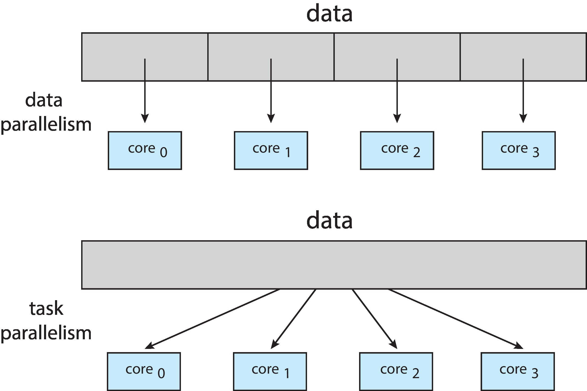
Multicore Programming
Types of parallelism
Data parallelism – distributes subsets of the same data across multiple cores, same operation on each
Task parallelism – distributing threads across cores, each thread performing unique operation

Slide 11
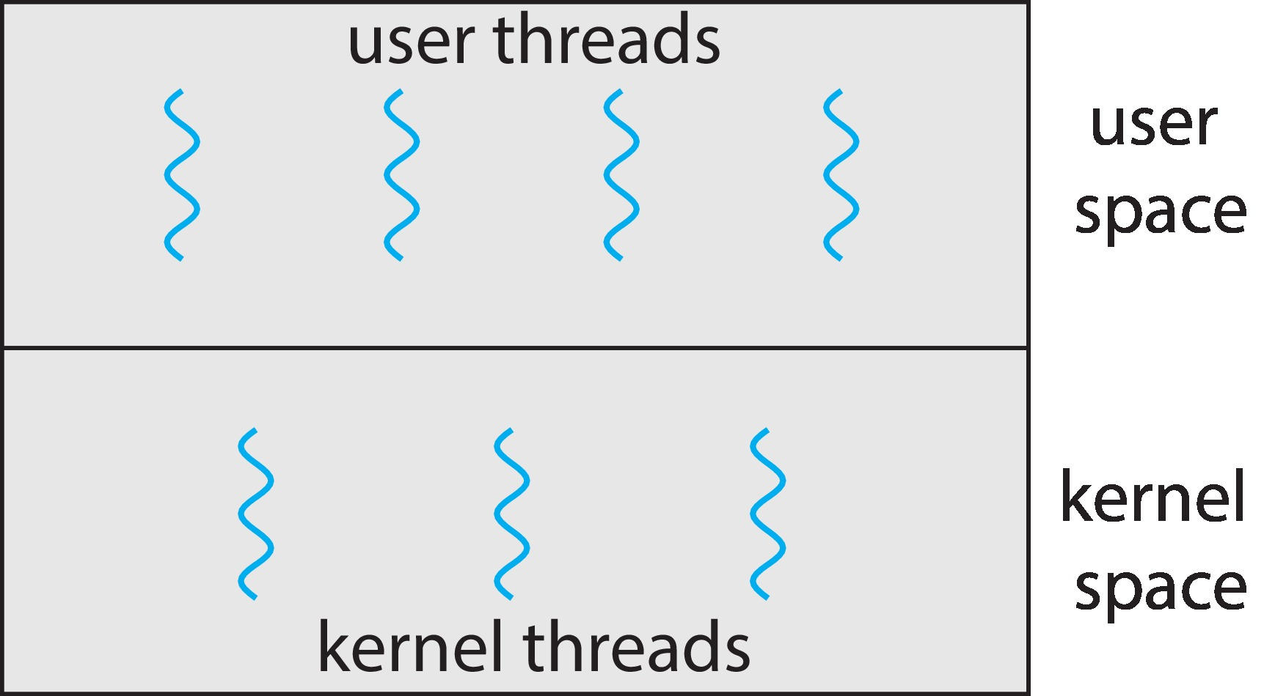
User Threads and Kernel Threads
User threads - management done by user-level threads library
Three primary thread libraries:
POSIX Pthreads
Windows threads
Java threads
Kernel threads - Supported by the Kernel
Examples – virtually all general -purpose operating systems, including:
Windows
Linux
Mac OS X
iOS
Android

Slide 12
Multithreading Models
Many-to-One
One-to-One
Many-to-Many

Slide 13
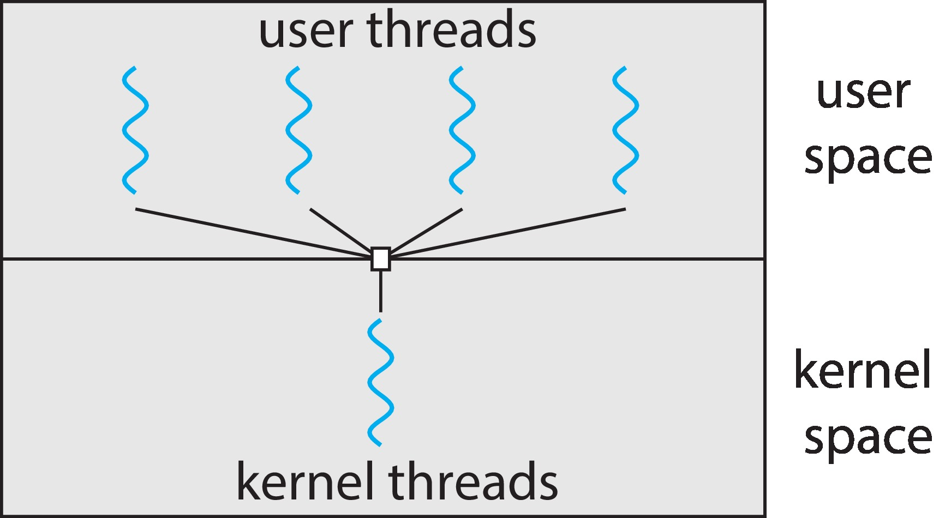
Many-to-One
Many user-level threads mapped to single kernel thread
One thread blocking causes all to block
Multiple threads may not run in parallel on muticore system because only one may be in kernel at a time
Few systems currently use this model
Examples:
Solaris Green Threads
GNU Portable Threads

Slide 14
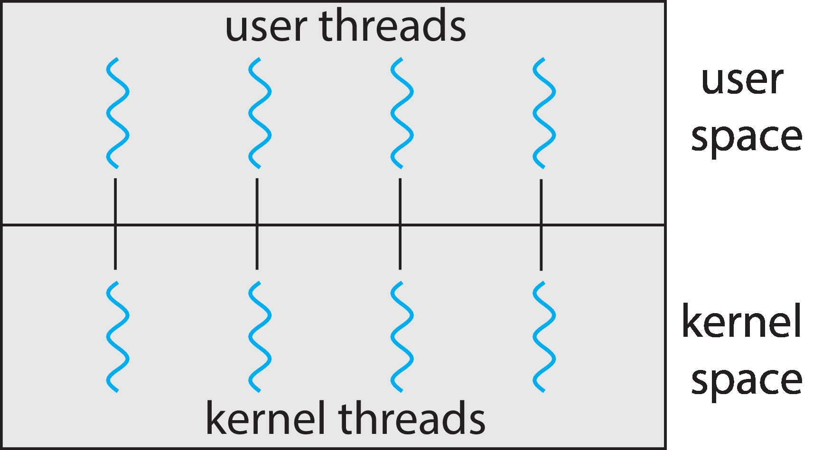
One-to-One
Each user-level thread maps to kernel thread
Creating a user-level thread creates a kernel thread
More concurrency than many-to-one
Number of threads per process sometimes restricted due to overhead
Examples
Windows
Linux

Slide 15
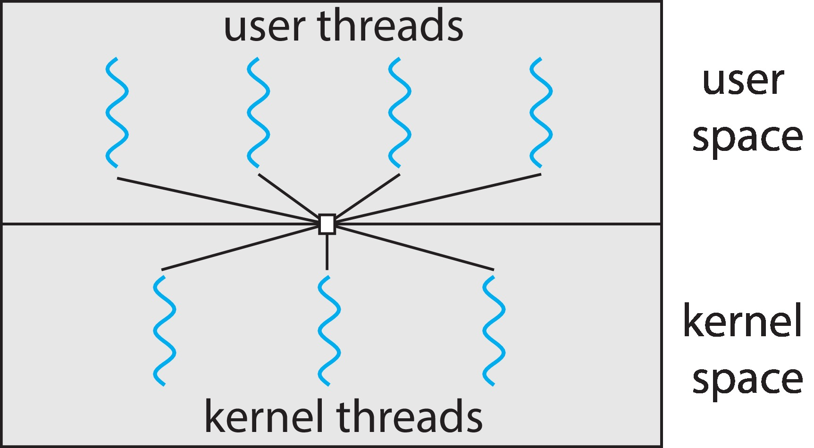
Many-to-Many Model
Allows many user level threads to be mapped to many kernel threads
Allows the operating system to create a sufficient number of kernel threads
Windows with the ThreadFiber package
Otherwise not very common

Slide 16
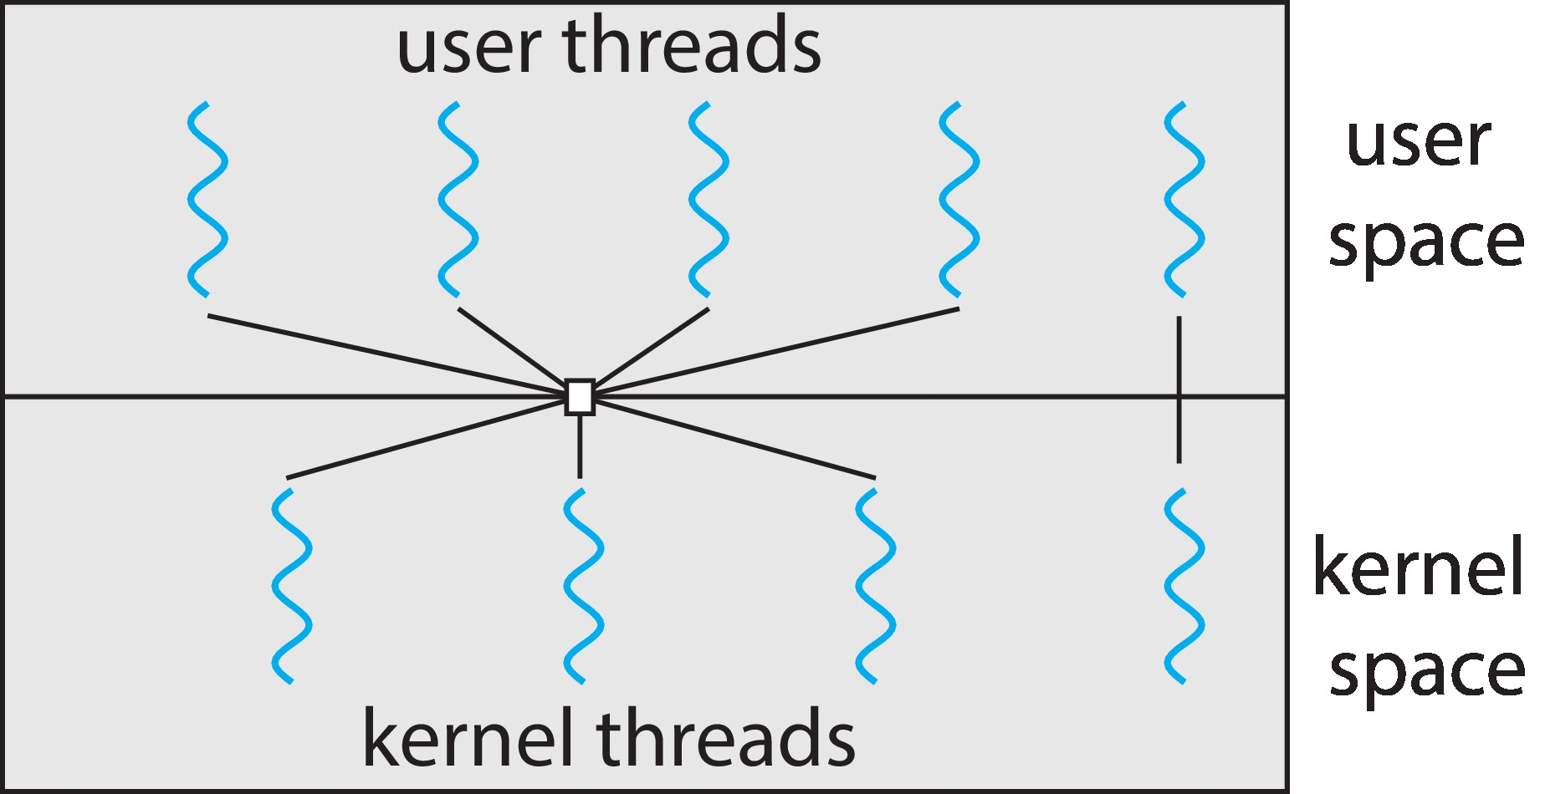
Two-level Model
Similar to M:M, except that it allows a user thread to be bound to kernel thread

Slide 17
End of Chapter 4

Slide 18
Outline
Basic Concepts
Scheduling Criteria
Scheduling Algorithms

Slide 19
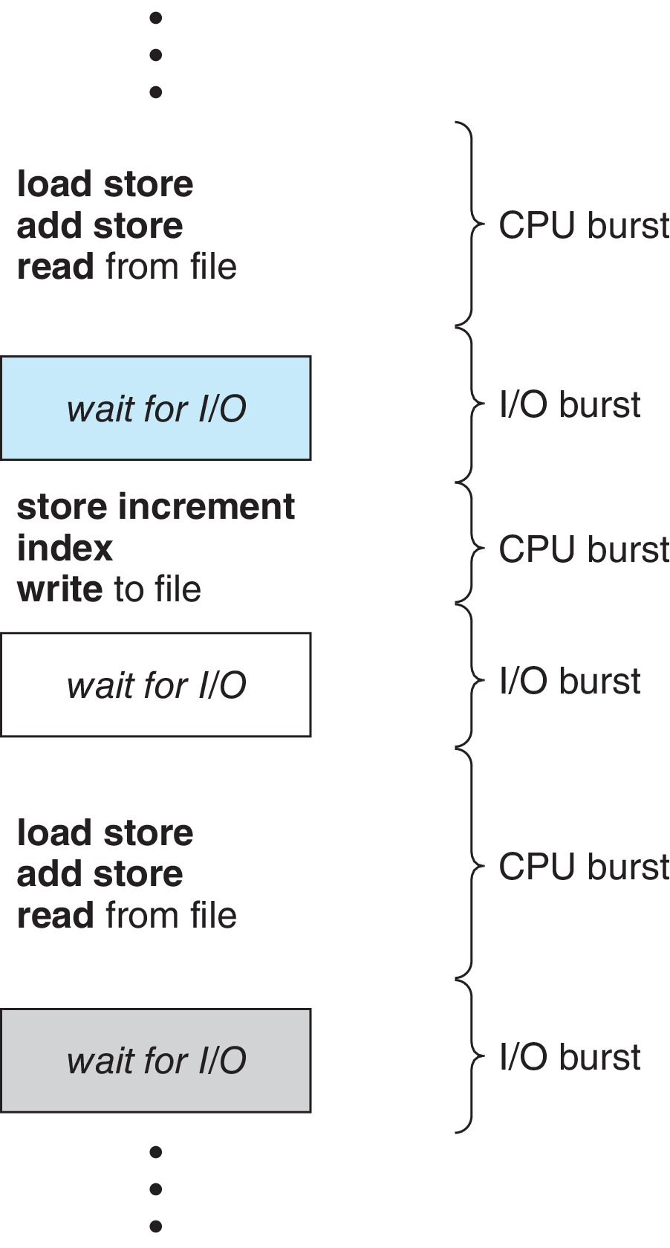
Basic Concepts
Maximum CPU utilization obtained with multiprogramming
CPU–I/O Burst Cycle – Process execution consists of a cycle of CPU execution and I/O wait
CPU burst followed by I/O burst
CPU burst distribution is of main concern

Slide 20
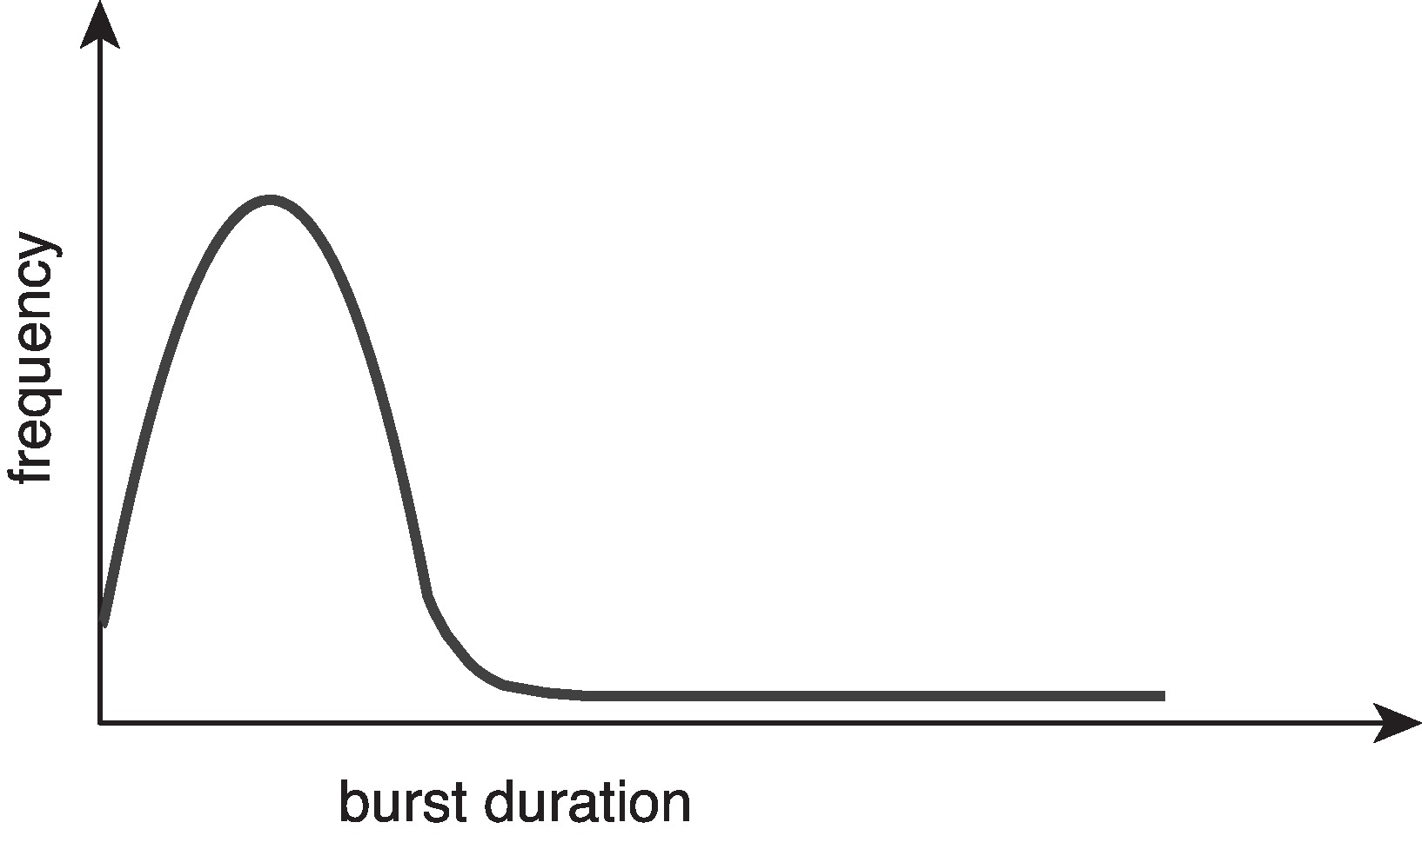
Histogram of CPU-burst Times
Large number of short bursts
Small number of longer bursts
Histogram

Slide 21
CPU Scheduler
The CPU scheduler selects from among the processes in ready queue, and allocates a CPU core to one of them
The ready queue may be ordered in various ways
CPU scheduling decisions may take place when a process:
1. Switches from running to waiting state
2. Switches from running to ready state
3. Switches from waiting to ready
Terminates
For situations 1 and 4, there is no choice in terms of scheduling. A new process (if one exists in the ready queue) must be selected for execution.
For situations 2 and 3, however, there is a choice.

Slide 22
Preemptive and Nonpreemptive Scheduling
When scheduling takes place only under circumstances 1 and 4, the scheduling scheme is nonpreemptive.
Otherwise, it is preemptive.
Under Nonpreemptive scheduling, once the CPU has been allocated to a process, the process keeps the CPU until it releases it either by terminating or by switching to the waiting state.
What is the potential problem?
Virtually all modern operating systems including Windows, MacOS, Linux, and UNIX use preemptive scheduling algorithms.

Slide 23
Preemptive Scheduling and Race Conditions
Preemptive scheduling can result in race conditions when data are shared among several processes.
Consider the case of two processes that share data. While one process is updating the data, it is preempted so that the second process can run. The second process then tries to read the data, which are in an inconsistent state.
We saw this in the bounded buffer example
This issue will be explored in detail in Chapter 6.

Slide 24
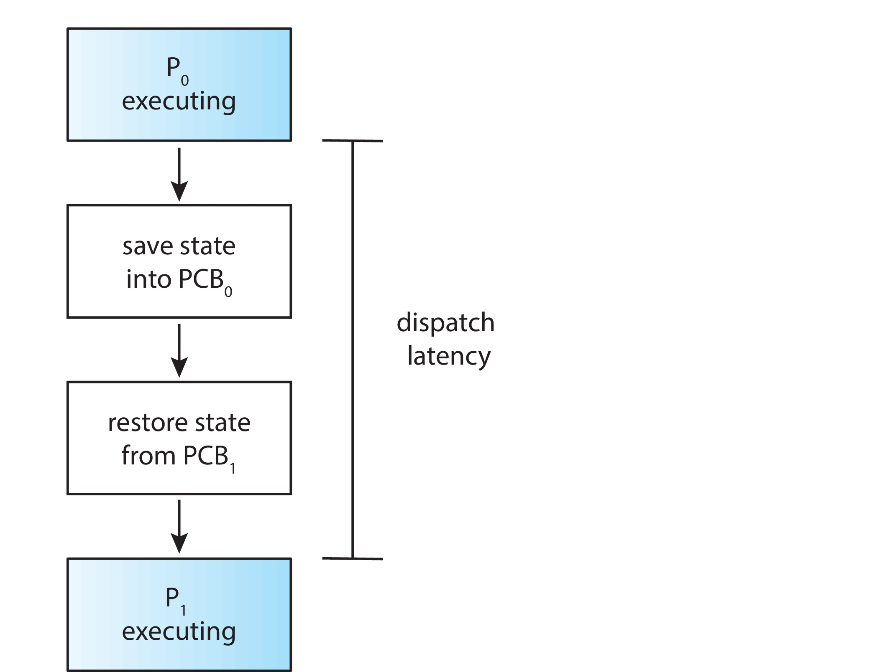
Dispatcher
Dispatcher module gives control of the CPU to the process selected by the CPU scheduler;
this involves:
Switching context
Switching to user mode
Jumping to the proper location in the user program to restart that program
Dispatch latency – time it takes for the dispatcher to stop one process and start another running

Slide 25
Scheduling Criteria
CPU utilization – keep the CPU as busy as possible
Throughput – # of processes that complete their execution per time unit
Turnaround time – amount of time to execute a particular process
Waiting time – amount of time a process has been waiting in the ready queue
Response time – amount of time it takes from when a request was submitted until the first response is produced.
Max CPU utilization
Max throughput
Min turnaround time
Min waiting time
Min response time

Slide 26
First- Come, First-Served (FCFS) Scheduling
Example with 3 processes
Process Burst Time
P₁ 24
P₂ 3
P₃ 3
Suppose that the processes arrive in the order: P₁ , P₂ , P₃ The Gantt Chart for the above schedule is:
Waiting time for P₁ = 0; P₂ = 24; P₃ = 27
Average waiting time: (0 + 24 + 27)/3 = 17

Slide 27
FCFS Scheduling (Cont.)
Suppose that the processes arrive in the order:
P₂ , P₃ , P₁
The Gantt chart for the schedule is:
Waiting time for P₁ = 6; P₂ = 0; P₃ = 3
Average waiting time: (6 + 0 + 3)/3 = 3
Much better than previous case
Convoy effect - short process behind long process
Consider one CPU-bound and many I/O-bound processes

Slide 28
Shortest-Job-First (SJF) Scheduling
Associate with each process the length of its next CPU burst
Use these lengths to schedule the process with the shortest time
SJF is optimal – gives minimum average waiting time for a given set of processes
How do we determine the length of the next CPU burst?
Could ask the user
Estimate

Slide 29
Example of SJF
ProcessArriv l Time Burst Time
P₁ 0.0 6
P₂ 2.0 8
P₃ 4.0 7
P₄ 5.0 3
SJF scheduling chart
Average waiting time = (3 + 16 + 9 + 0) / 4 = 7

Slide 30

Determining Length of Next CPU Burst
Can only estimate the length – should be similar to the previous one
Then pick process with shortest predicted next CPU burst
Can be done by using the length of previous CPU bursts, using exponential averaging
Commonly, α set to ½

Slide 31
Shortest Remaining Time First Scheduling
Preemptive version of SJN
Whenever a new process arrives in the ready queue, the decision on which process to schedule next is redone using the SJN algorithm.
Is SRT more “optimal” than SJN in terms of the minimum average waiting time for a given set of processes?

Slide 32
Example of Shortest-remaining-time-first
Now we add the concepts of varying arrival times and preemption to the analysis
ProcessA arri Arrival TimeT Burst Time
P₁ 0 8
P₂ 1 4
P₃ 2 9
P₄ 3 5
Preemptive SJF Gantt Chart
Average waiting time = [(10-1)+(1-1)+(17-2)+(5-3)]/4 = 26/4 = 6.5

Slide 33
Round Robin (RR)
Each process gets a small unit of CPU time (time quantum q), usually 10-100 milliseconds. After this time has elapsed, the process is preempted and added to the end of the ready queue.
If there are n processes in the ready queue and the time quantum is q, then each process gets 1/n of the CPU time in chunks of at most q time units at once. No process waits more than (n-1)q time units.
Timer interrupts every quantum to schedule next process
Performance
q large ⇒ FIFO
q small ⇒ q must be large with respect to context switch, otherwise overhead is too high

Slide 34
Example of RR with Time Quantum = 4
Process Burst Time
P₁ 24
P₂ 3
P₃ 3
The Gantt chart is:
Typically, higher average turnaround than SJF, but better response
q should be large compared to context switch time
q usually 10 milliseconds to 100 milliseconds,
Context switch < 10 microseconds

Slide 35
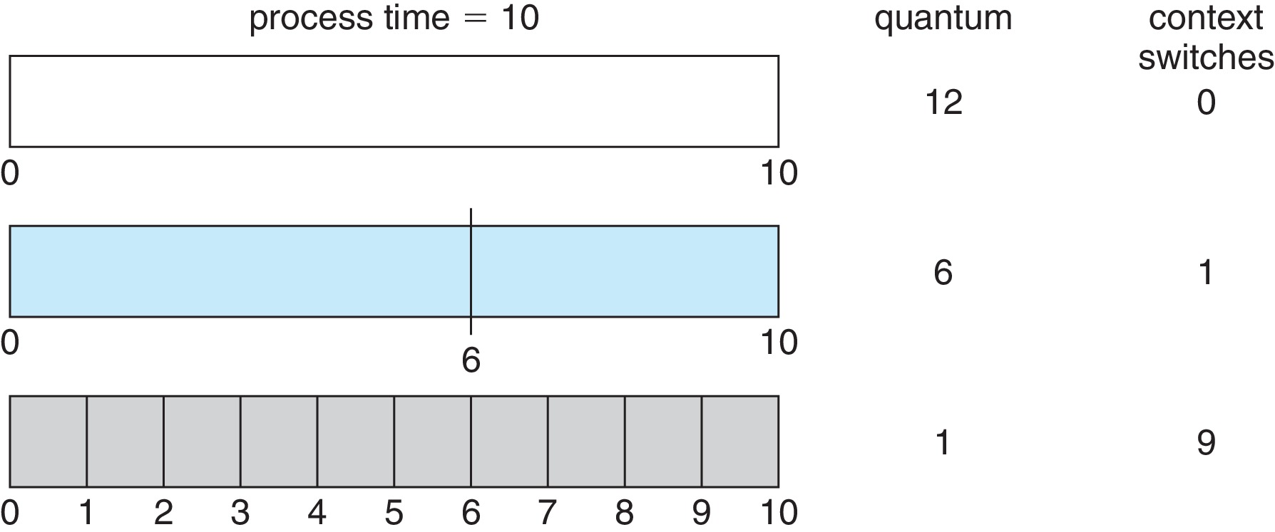
Time Quantum and Context Switch Time

Slide 36
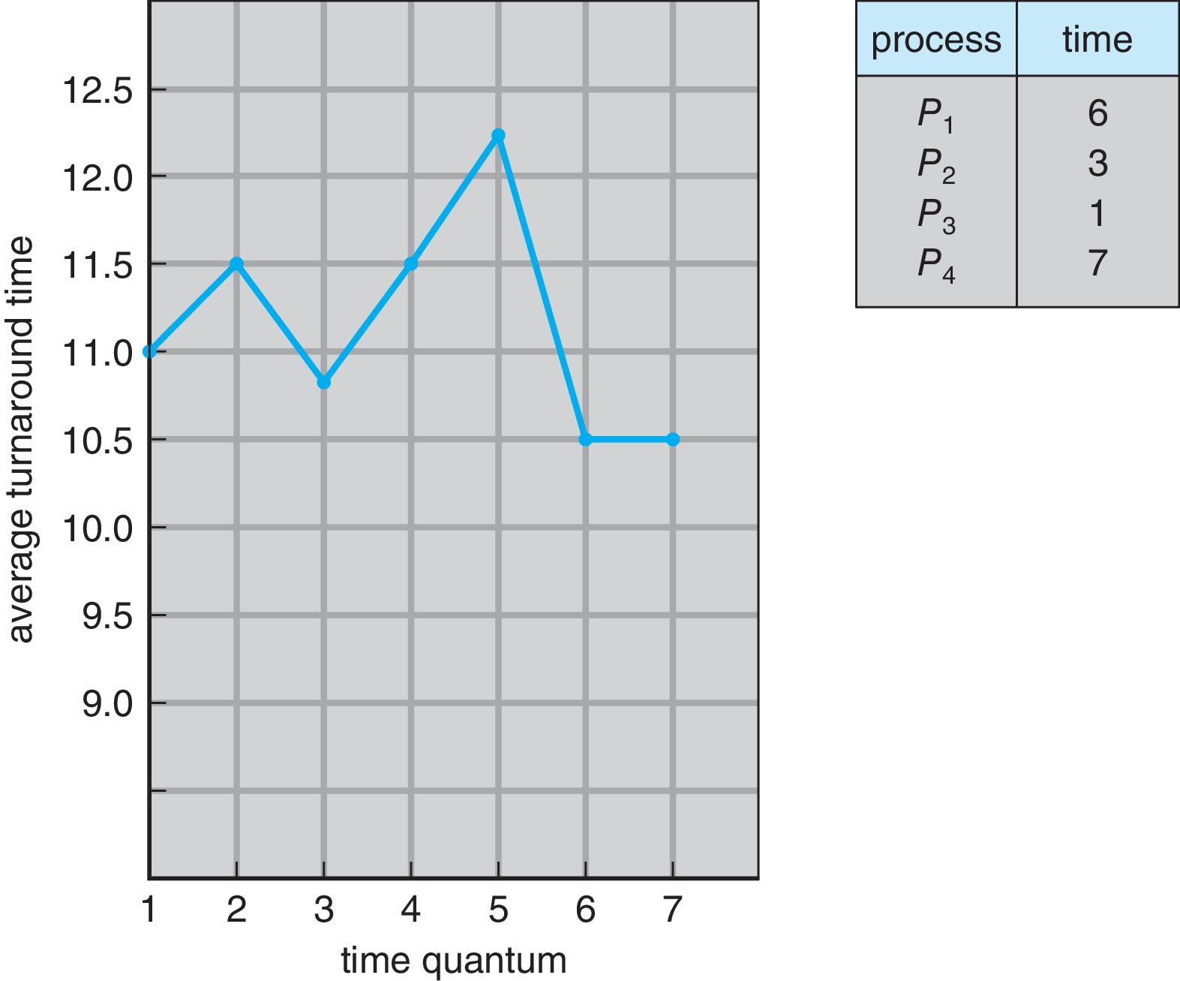
Turnaround Time Varies With The Time Quantum
80% of CPU bursts should be shorter than q

Slide 37
Priority Scheduling
A priority number (integer) is associated with each process
The CPU is allocated to the process with the highest priority (usually, smallest integer ≡ highest priority)
Two schemes:
Preemptive
Nonpreemptive
Problem ≡ Starvation – low priority processes may never execute
Solution ≡ Aging – as time progresses increase the priority of the process
Note: SJF is priority scheduling where priority is the inverse of predicted next CPU burst time

Slide 38
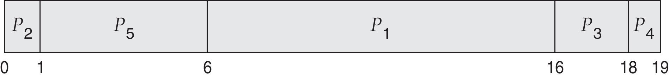
Example of Priority Scheduling
ProcessA arri Burst TimeT Priority
P₁ 10 3
P₂ 1 1
P₃ 2 4
P₄ 1 5
P₅ 5 2
Priority scheduling Gantt Chart
Average waiting time = 8.2

Slide 39
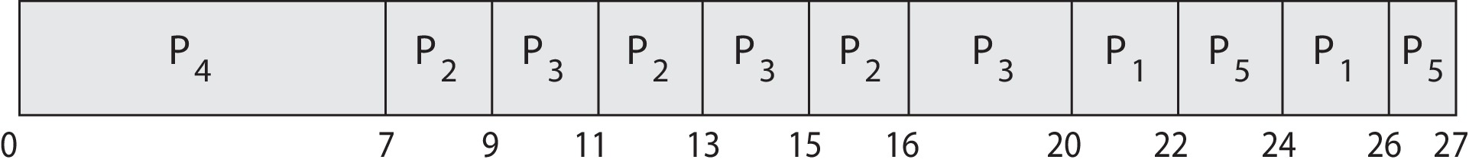
Priority Scheduling w/ Round-Robin
Run the process with the highest priority. Processes with the same priority run round-robin
Example:
Process a Burst Time Priority
P₁ 4 3
P₂ 5 2
P₃ 8 2
P₄ 7 1
P₅ 3 3
Gantt Chart with time quantum = 2

Slide 40
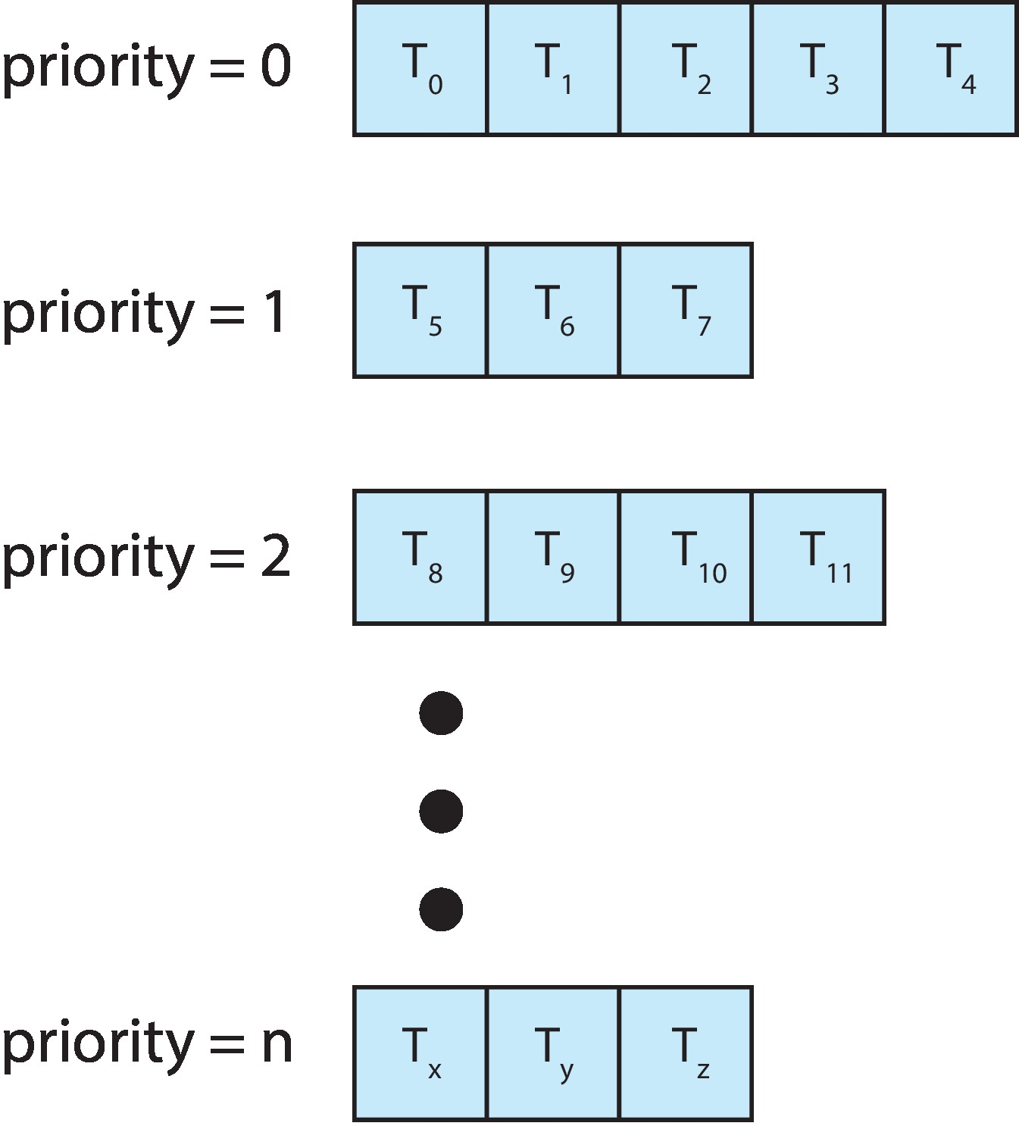
Multilevel Queue
The ready queue consists of multiple queues
Example:
Priority scheduling, where each priority has its separate queue.
Schedule the process in the highest-priority queue!

Slide 41
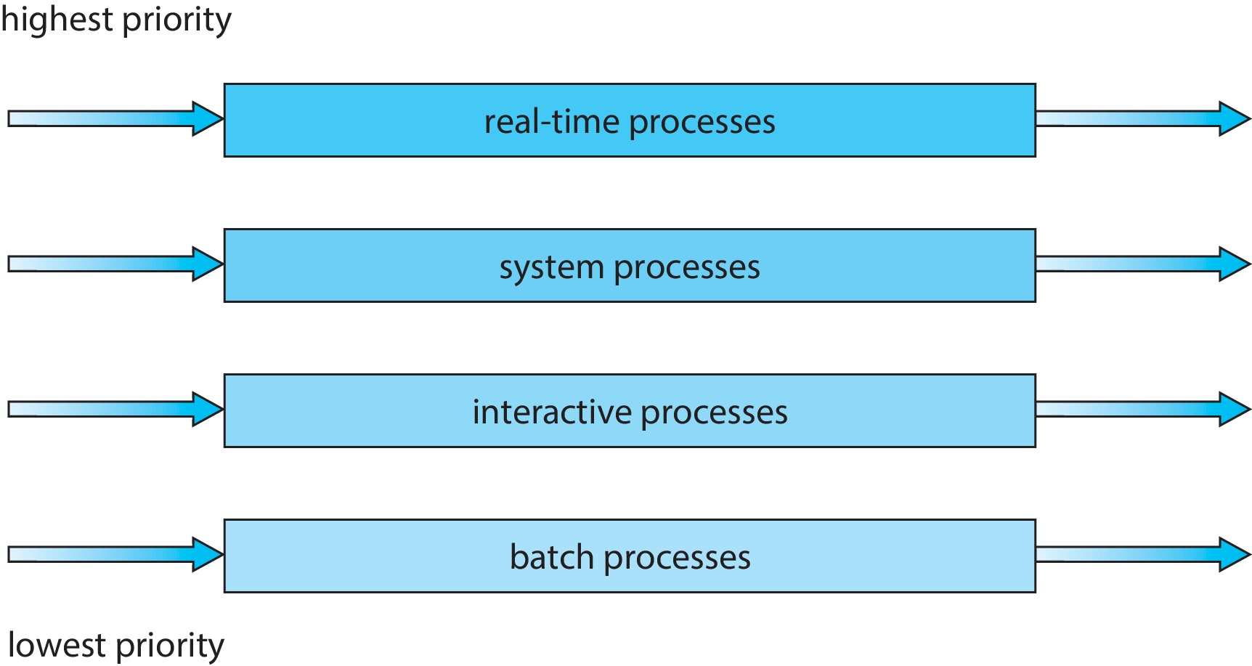
Multilevel Queue
Prioritization based upon process type

Slide 42
Multilevel Feedback Queue
A process can move between the various queues.
Multilevel-feedback-queue scheduler defined by the following parameters:
Number of queues
Scheduling algorithms for each queue
Method used to determine when to upgrade a process
Method used to determine when to demote a process
Method used to determine which queue a process will enter when that process needs service
Aging can be implemented using multilevel feedback queue

Slide 43
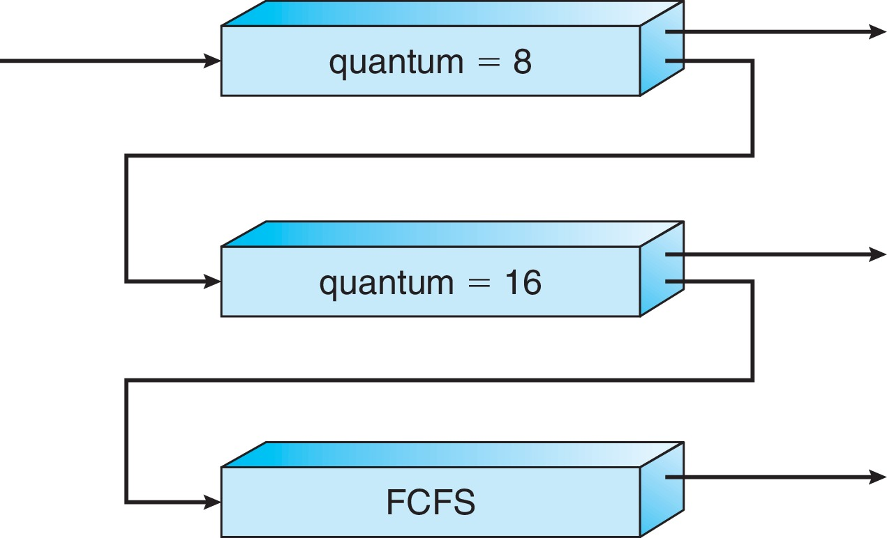
Example of Multilevel Feedback Queue
Three queues:
Q₀ – RR with time quantum 8 milliseconds
Q₁ – RR time quantum 16 milliseconds
Q₂ – FCFS
Scheduling
A new process enters queue Q₀ which is served in RR
When it gains CPU, the process receives 8 milliseconds
If it does not finish in 8 milliseconds, the process is moved to queue Q₁
At Q₁ job is again served in RR and receives 16 additional milliseconds
If it still does not complete, it is preempted and moved to queue Q₂

Slide 44
End of Chapter 5a

